Slide 1
ORNAT ( NATIVE ORGANICS )
MAIN PROJECT
BY
PAZHANISAMY.K
(REG.NO: A20MCS08 )
UNDER THE ABLE GUIDANCE
OF
Dr. A. VICTORIA ANAND MARY M.C.A., M.Phil., B.Ed., SET, Ph.D.,
Assistant. Professor
PG and Research Department of Computer Science
St. Joseph's College of Arts and Science (Autonomous), Cuddalore-1

Slide 2
CONTENT
ABSTRACT.
PROJECT REQUIREMENTS ( HARDWARE & SOFTWARE ).
MODULE DESCRIPTIONS ( ADMIN , USER ).
SAMPLE IMAGES ( ADMIN , USER ).
DATABASE DESCRIPTION ( ADMIN , USER ).
ADVANTAGES OF THE PROJECT.
CONCLUSSION & FUTURE ENHANCEMENT.

Slide 3
ABSTRACT
The main project titled “ORNAT (Native Organics )” is intended to develop an “Android Application” to enable the procurement and sales of multiple organic products including fruits , nuts , vegetables , oils , grams and etc.
The application provides the complete details of products.
The admin can add , modify and delete the products .
The customers can register with the application using OTP and view products.
The products can be searched after clicking the snap of the products and viewing its details , this application can be deployed for any super markets or organic products shops.
The project is developed using Android Studio IDE in flutter platform with Firebase as Database Application .

Slide 4
MODULE DESCRIPTION (ADMIN )
HOME , ADD EMPLOYEE , VIEW EMPLOYEE MODULE
The home module helps the admin to view the employee points , name .
ASSIGN PROJECT , PROJECT STATUS MODULE
The assign project module helps the admin to assign the projects to the employee with project name and date .
SALARY TABLE , EMPLOYEE LEAVE , LOGOUT MODULE
The salary table module helps the admin to view the salary of the employee basic , bonus and total salary .
The add employee module helps the admin to add the new employee to the company .
The project status module helps the admin to view the status of the project and assign the mark for the completed project .
The employee leave module helps the admin to view leave apply by the employee and take action by approve or cancel the leave request.
The view employee module helps the admin to view the employee details like name , DOB , contact , address etc …
The logout module helps the admin to logout from the admin module .

Slide 5
MODULE DESCRIPTION ( USER )
LOGIN , HOME
The home module helps the user view the products , select the products and shop the products by category .
CONTACT US , FEEDBACK
This module helps the user to view the project details assigned by the admin , due date of the project and the status of the project .
ABOUT US , LOGOUT , EXIT
The apply leave module helps the user to apply the leave by provide the start date , end date and reason for leave .
The login module helps the user to login to the application , Users can also create an account by new user module and also recover the user passwords by
The logout module helps the user to logout from the user module .

Slide 6
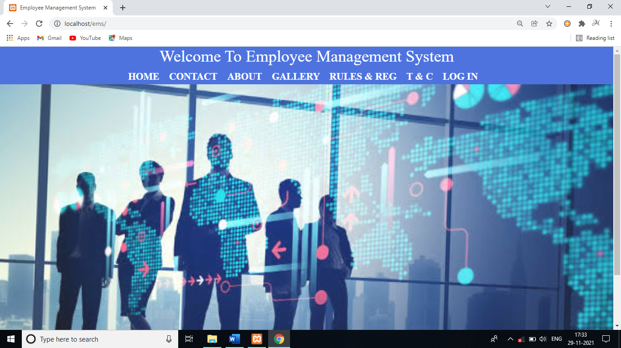
SAMPLE IMAGES ( GENERAL )

Slide 7
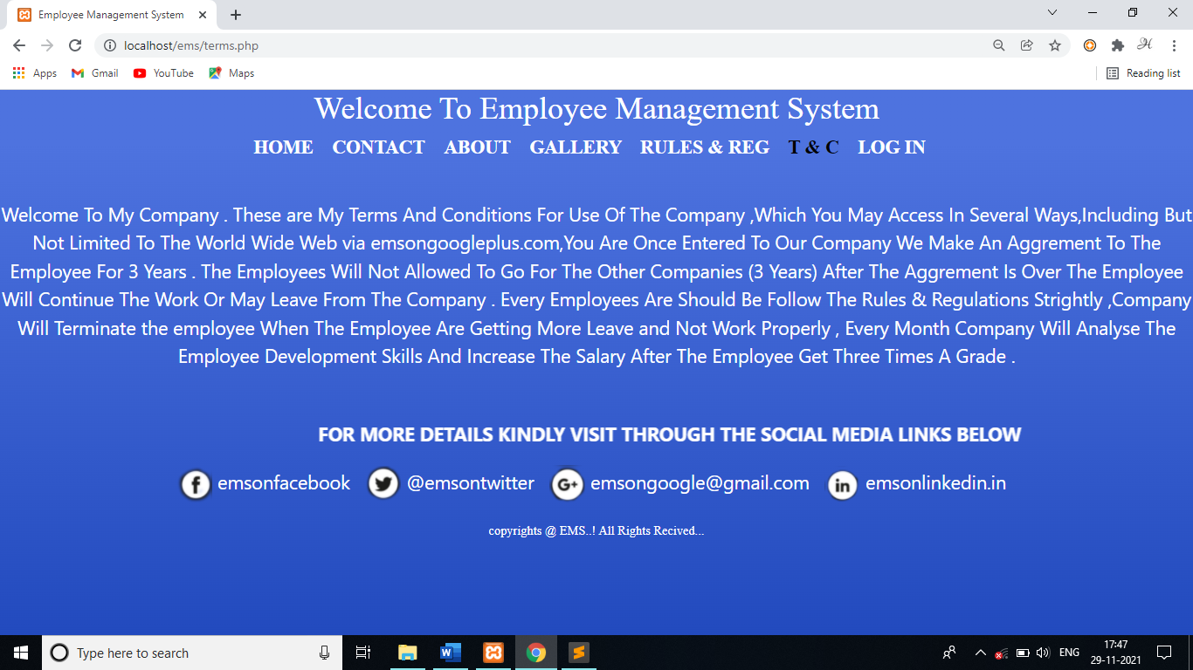
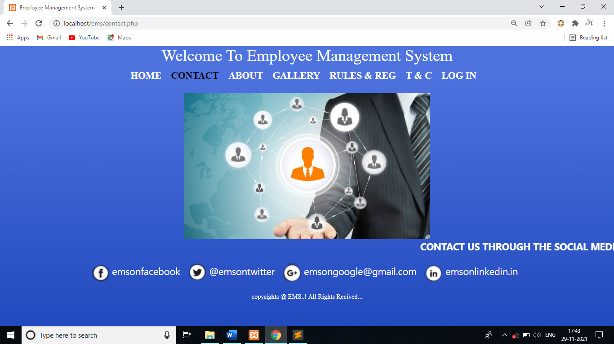
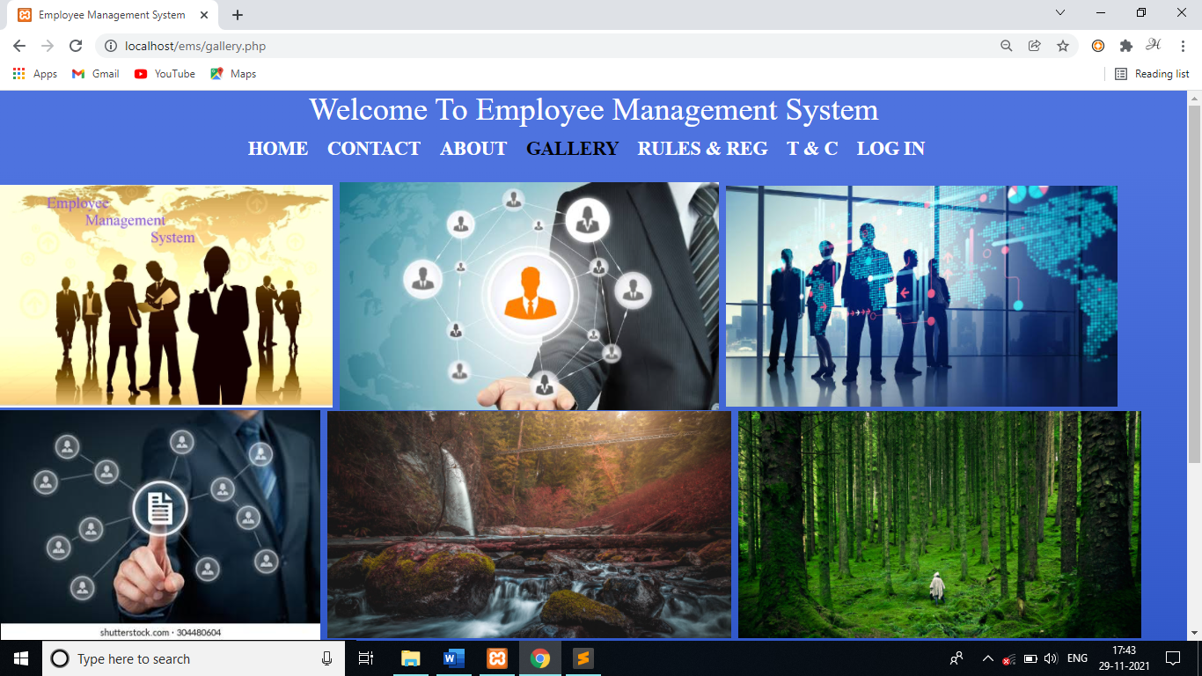
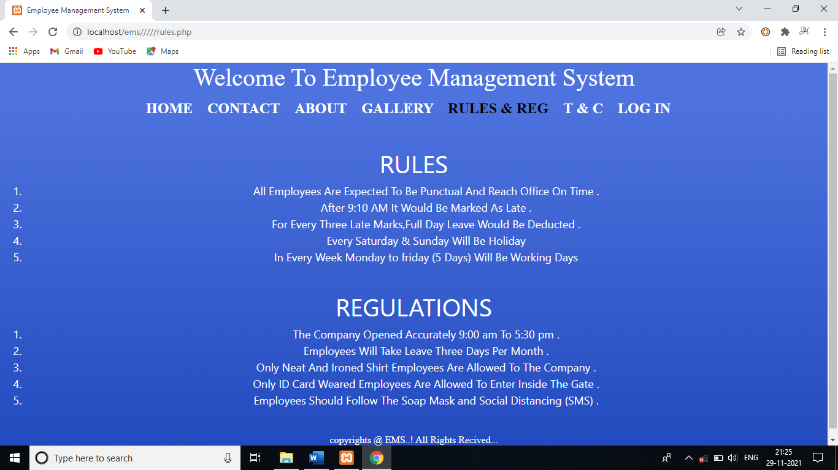
SAMPLE IMAGES ( GENERAL )

Slide 8
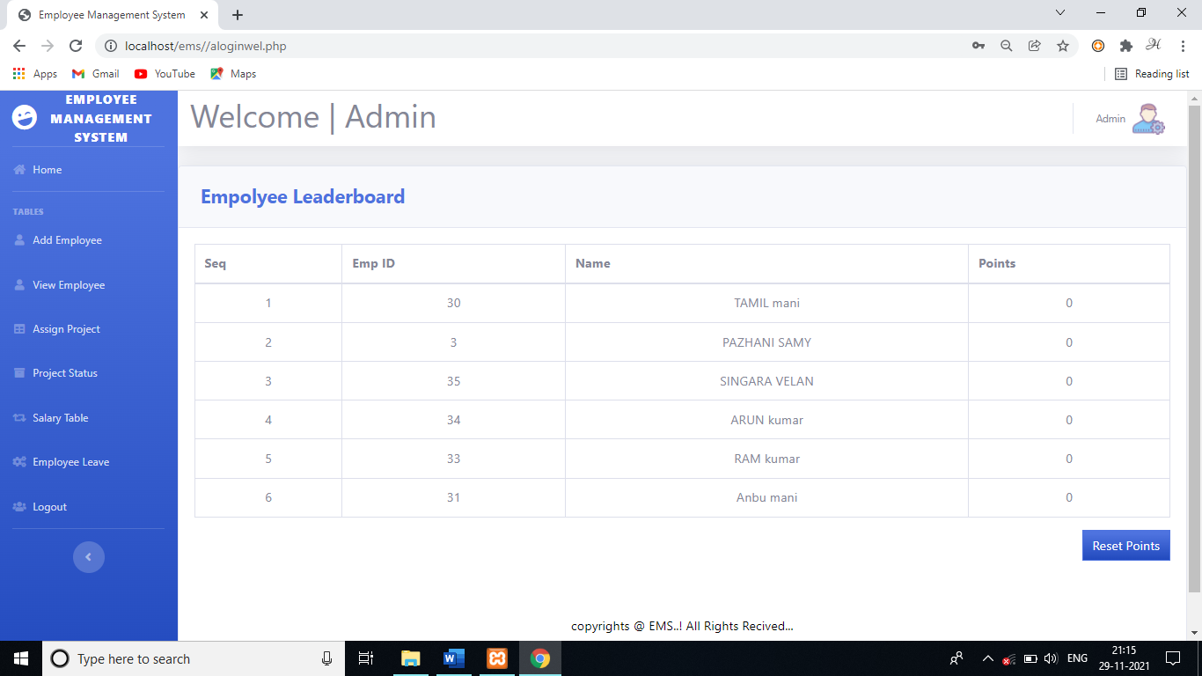
SAMPLE IMAGES ( ADMIN )

Slide 9
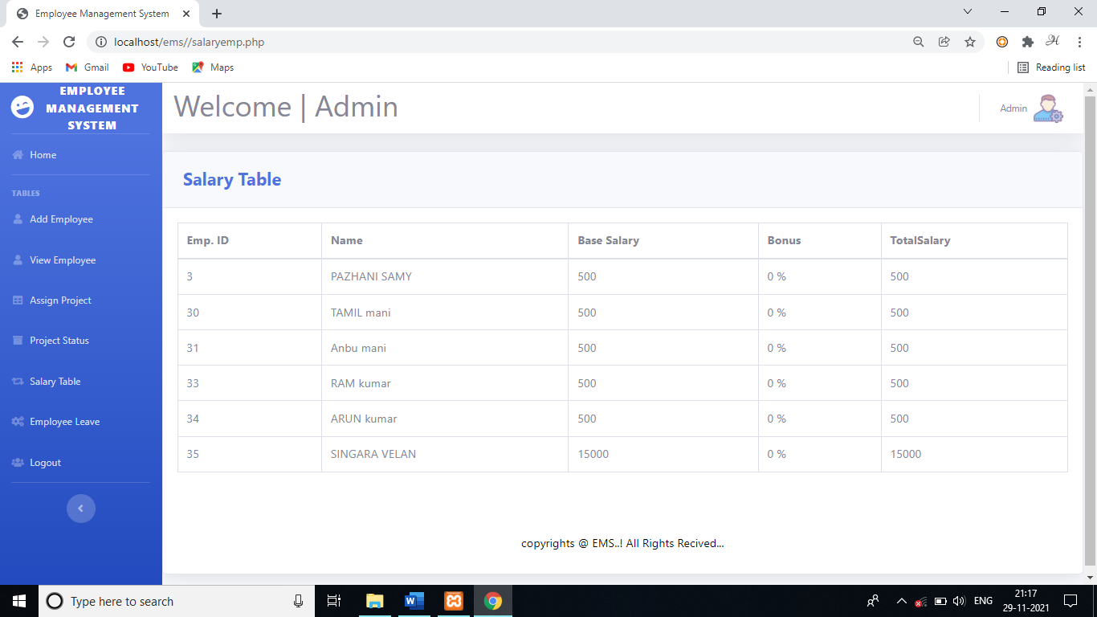
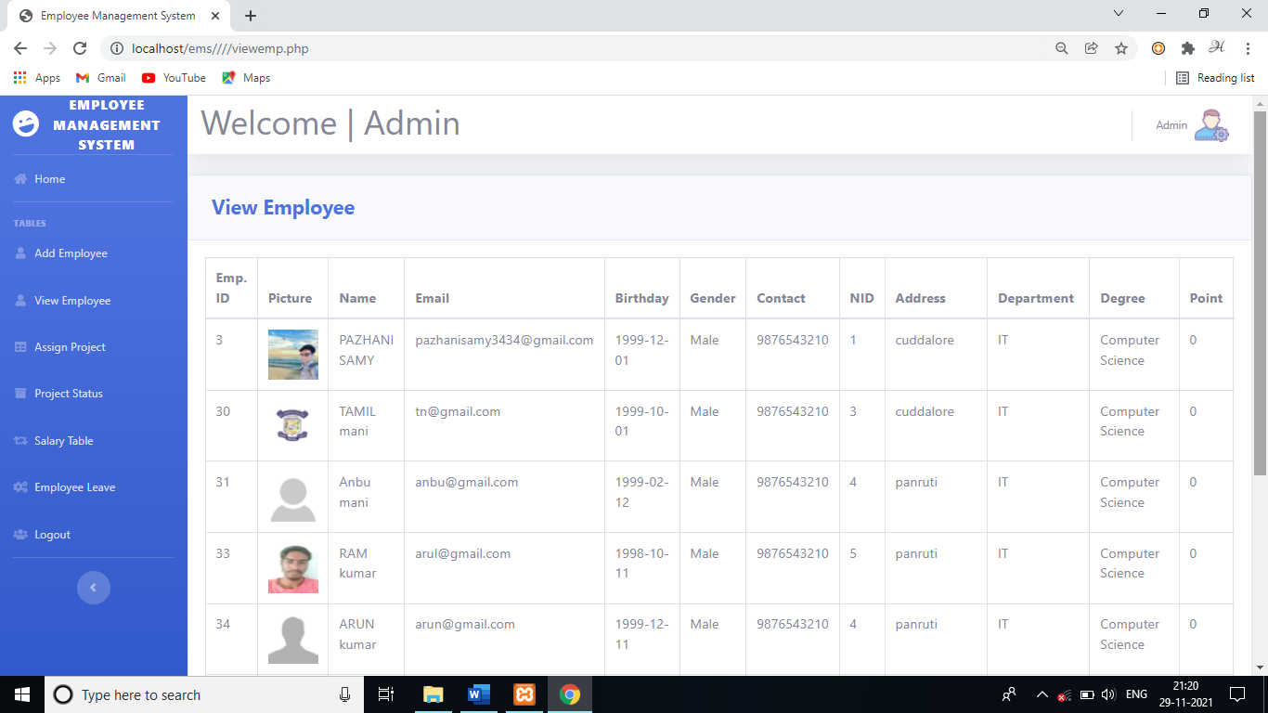
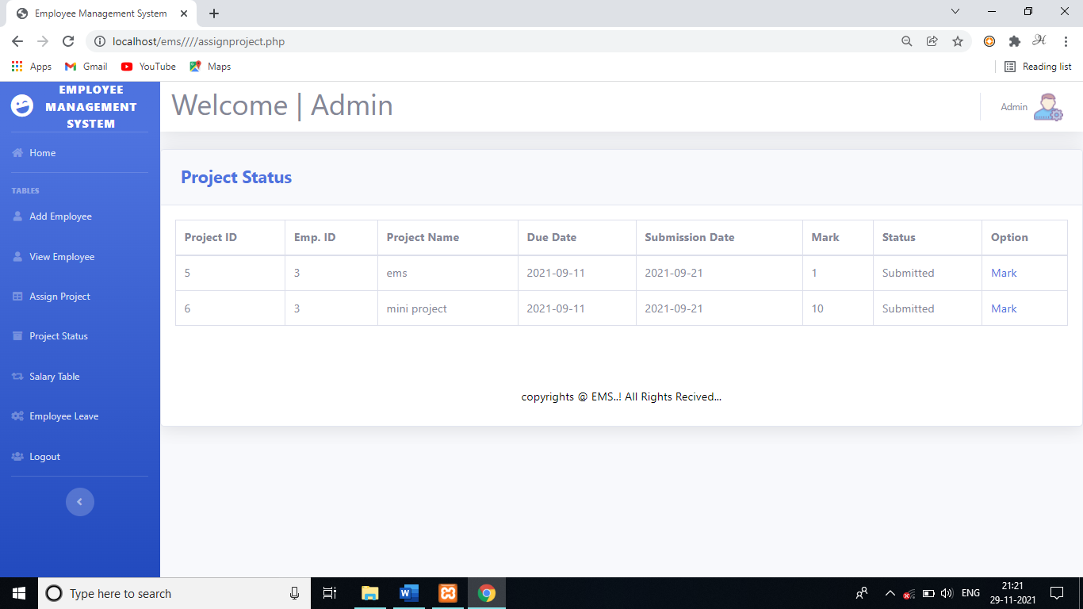
SAMPLE IMAGES ( ADMIN )

Slide 10
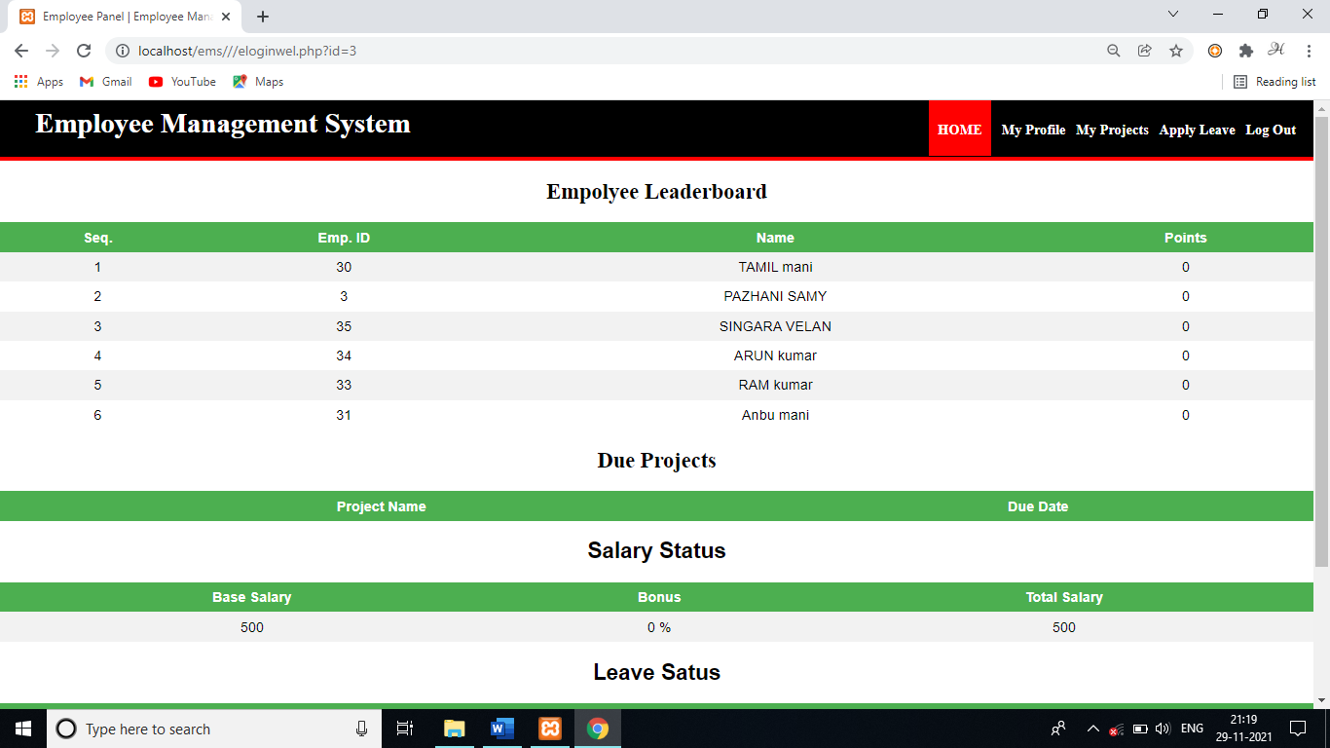
SAMPLE IMAGES ( USER )

Slide 11
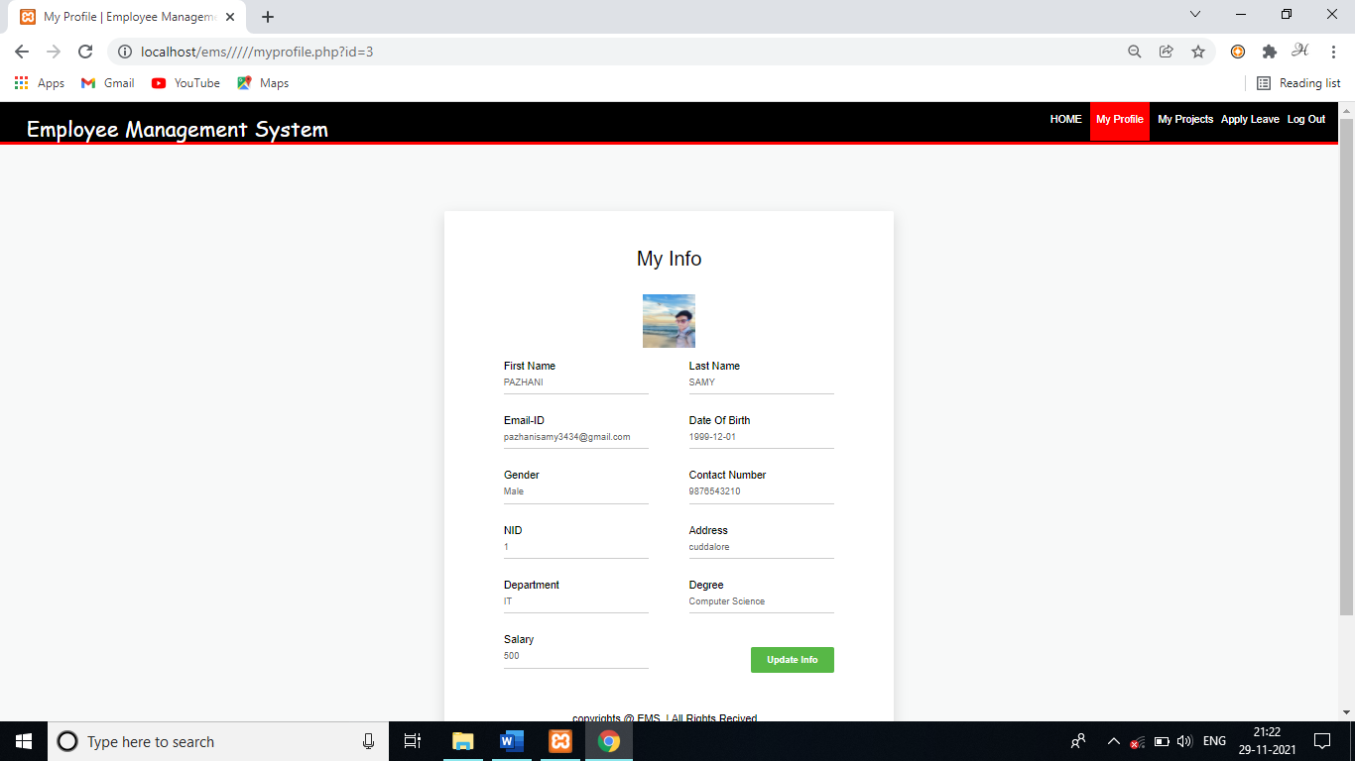
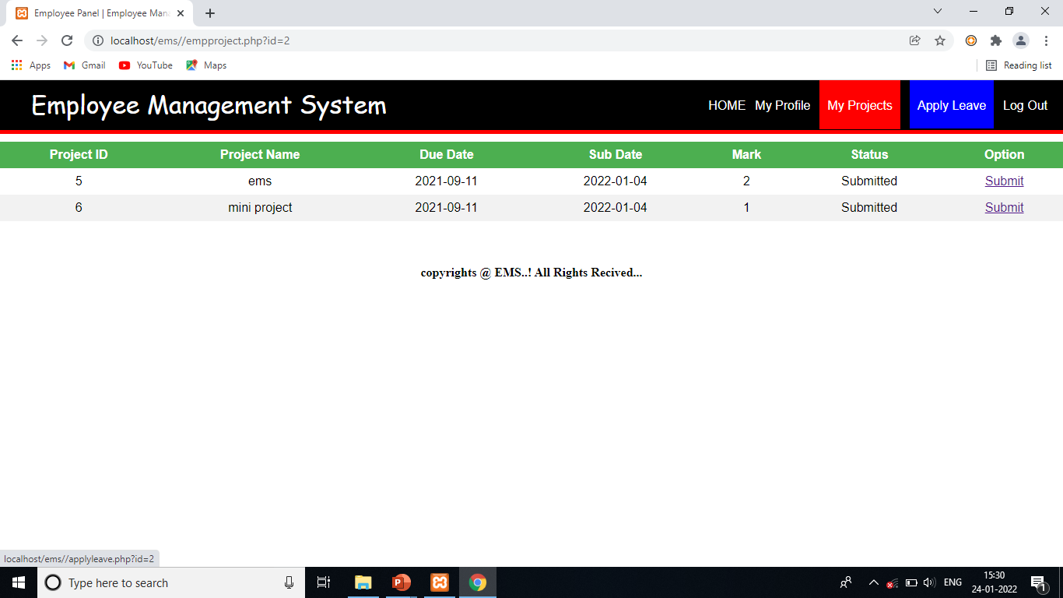
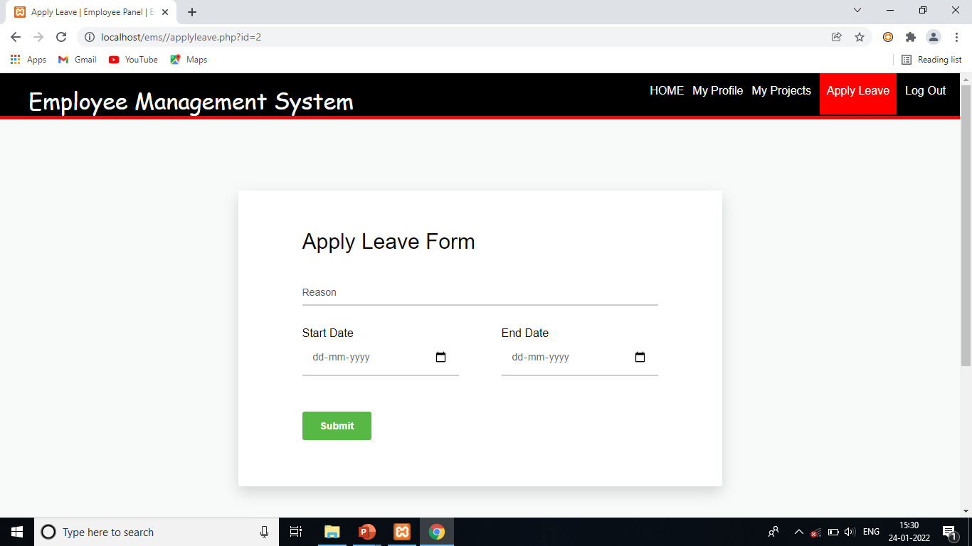
SAMPLE IMAGES ( USER )

Slide 12
DATABASE DESCRIPTION
DATABASE NAME | EMS
TABLE NAME | ALOGIN
FILED NAME | DATATYPE
Id | integer
Email | varchar
password | varchar

Slide 13
DATABASE DESCRIPTION
DATABASE NAME | EMS
TABLE NAME | EMPLOYEE
FILED NAME | DATATYPE
Id | integer
Firstname | varchar
Lastname | varchar
email | varchar
Password | Text
Birthday | Date
Gender | Varchar
Contact | Integer
Address | Varchar
Degree | Varchar

Slide 14
DATABASE DESCRIPTION
DATABASE NAME | EMS
TABLE NAME | SALARY
FILED NAME | DATATYPE
Id | Integer
Base | Integer
Bonus | Integer
Total | Integer

Slide 15
ADVANTAGES OF THE PROJECT
Reduce time consumption and easy to maintain the records .
Reduce cost of the record notes and easy to store .
Reduce workload of the user and handle the software easy .
Reduce space to store the software is very easy .
The software can reduce the cost , time , space , workload etc …..

Slide 16
CONCLUSION & FUTURE ENHANCEMENTS
Finally, the system is used to store the employee records using admin using localhost. The main idea of the project is to automate all the work of the employee .
View employee request
Work through online
Reports submit through online
In this project, many future plans may be implemented to this process. However future thinking has expanded hugely in scope and substance. This system can be expanded to be more user friendly & Secured. Some of them are listed below.
In future it can be developed as an application.
It will be made more user friendly than now.
There will be increased security and privacy.

Slide 17
EMPLOYEE MANAGEMENT SYSTEM
MINI PROJECT WORK
BY
PAZHANISAMY.K
(REG.NO: A20MCS08 )
THANK YOU

